Slide 1
Deep Neural Networks
Deep L-layer
Neural network

Slide 2
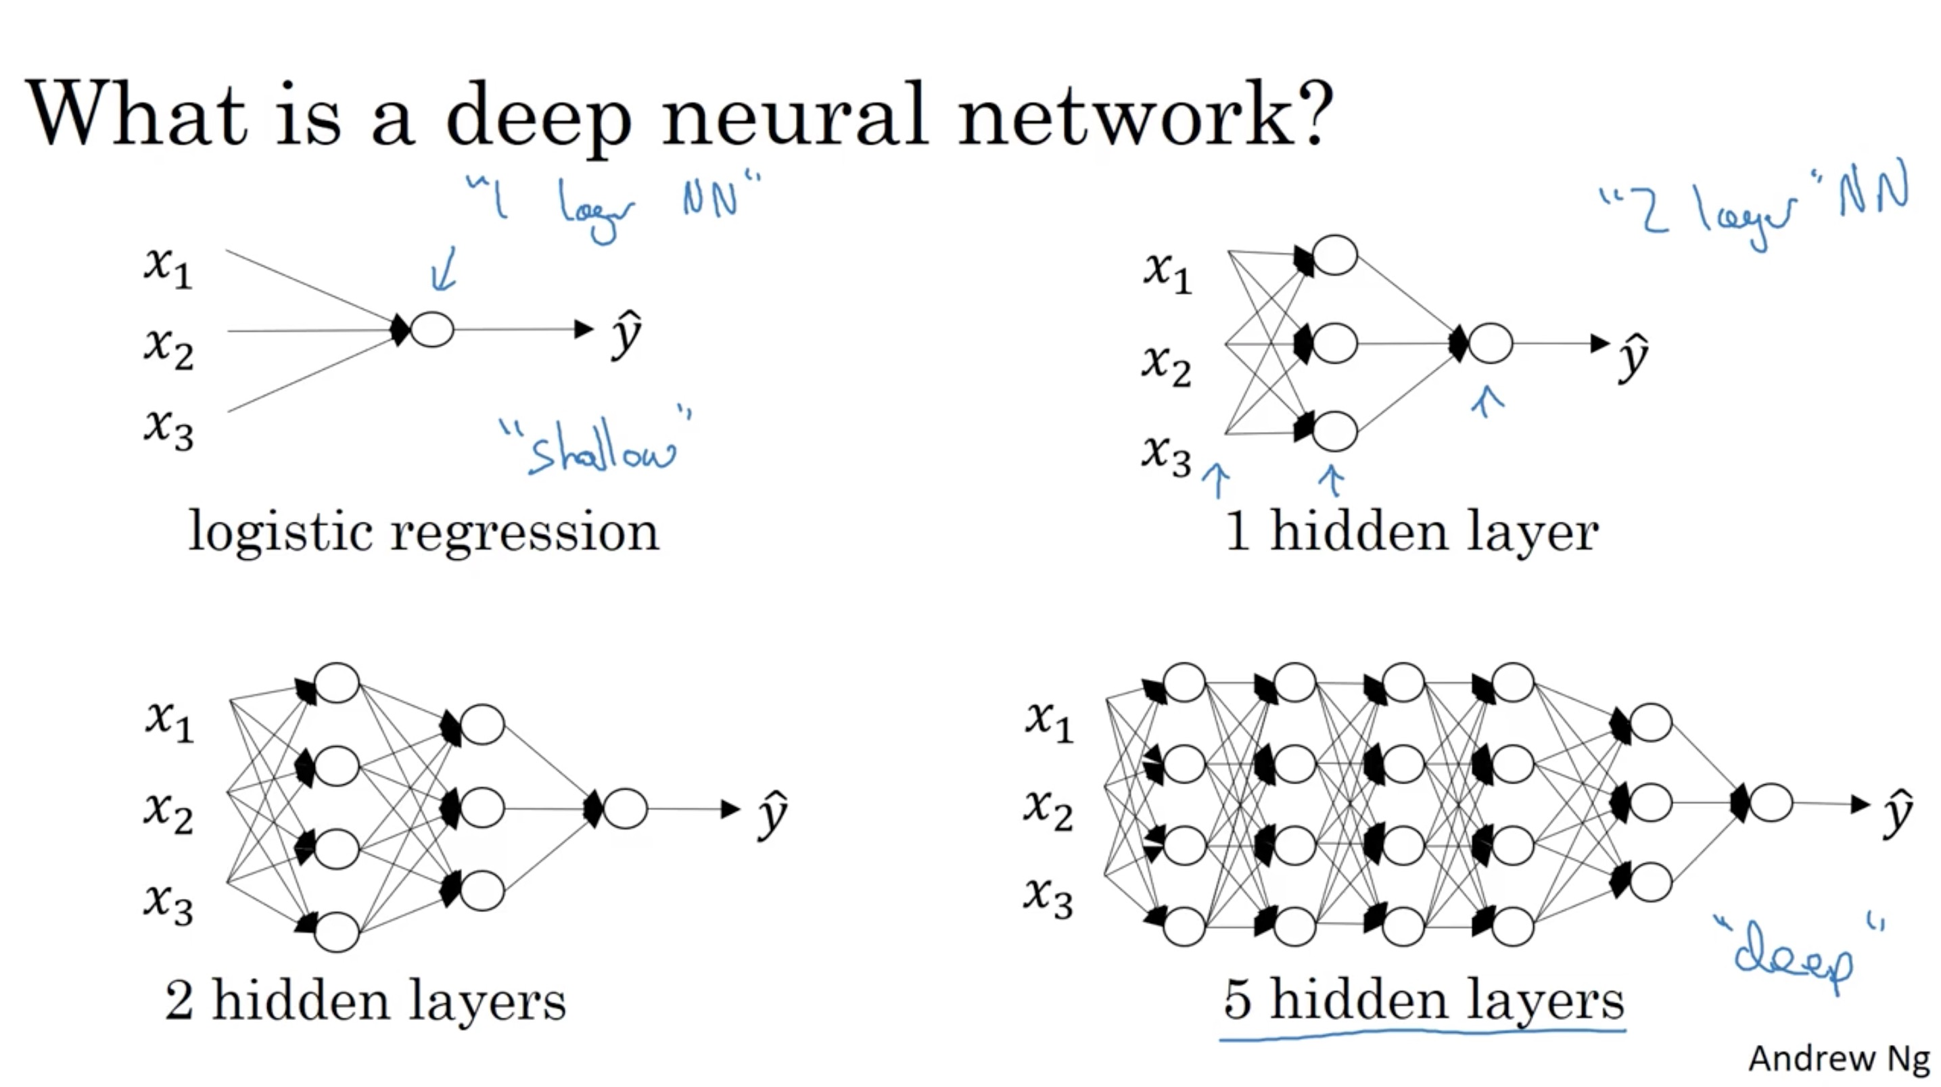

Slide 3
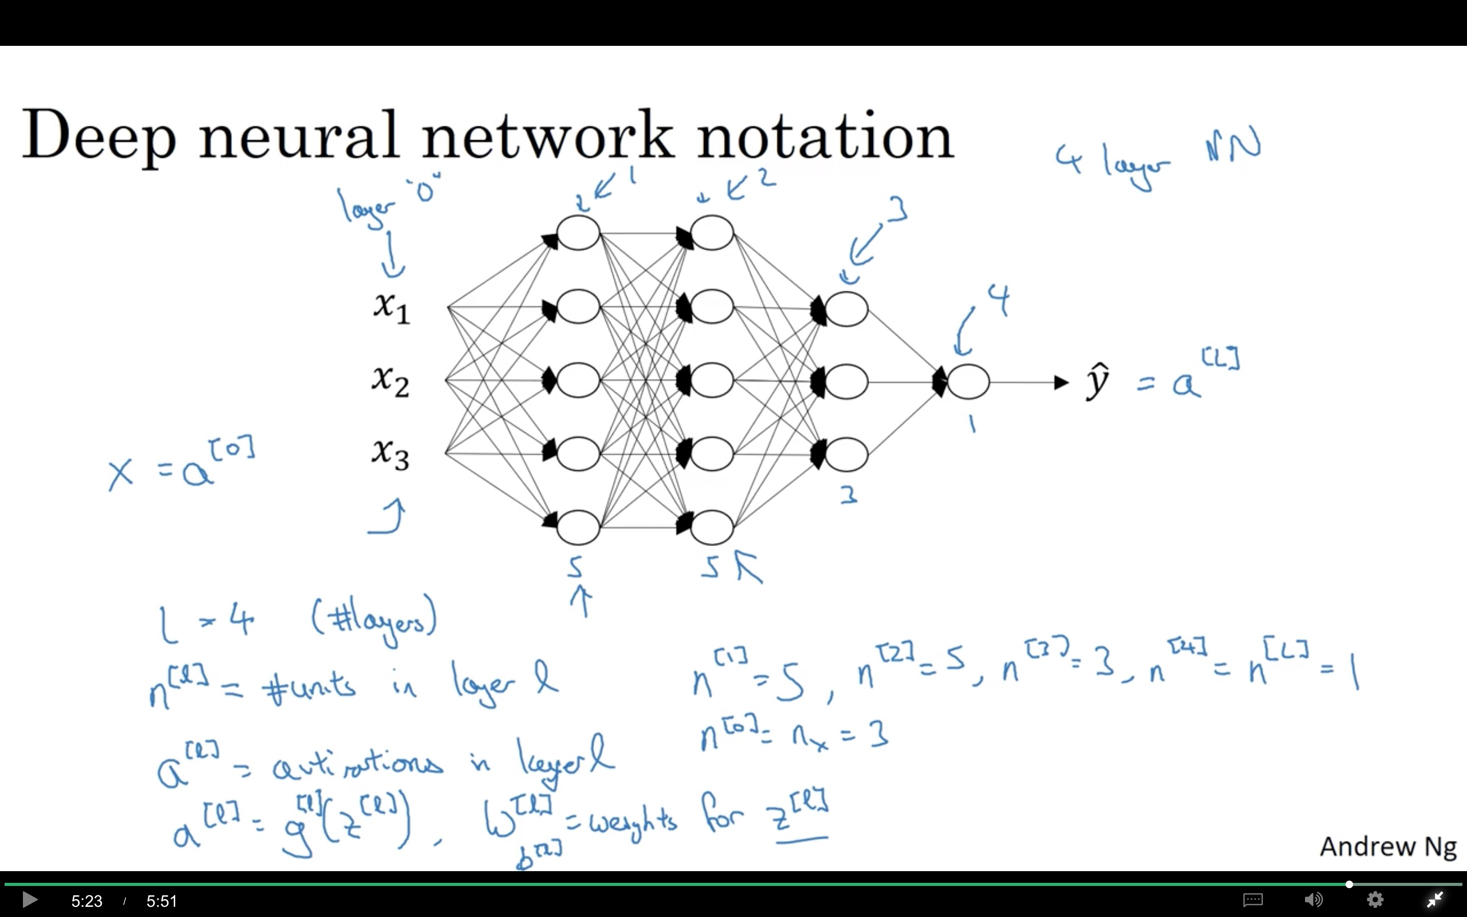

Slide 4
Deep Neural Networks
Forward Propagation
in a Deep Network

Slide 5
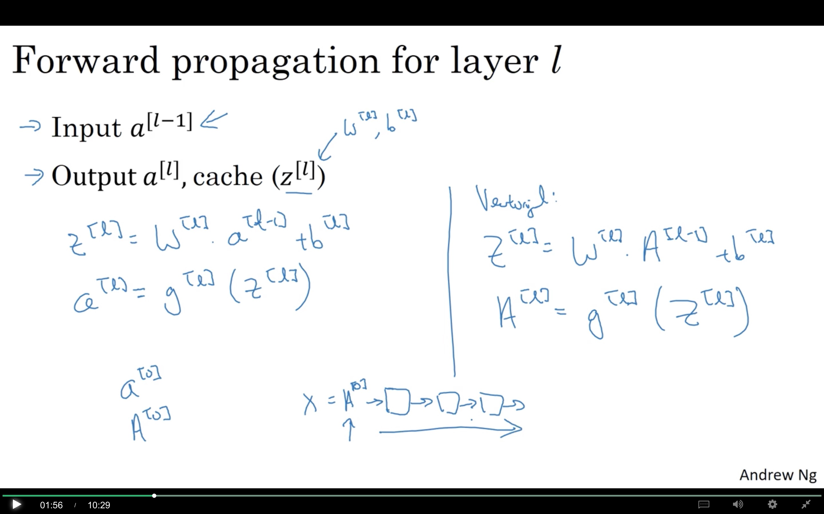

Slide 6
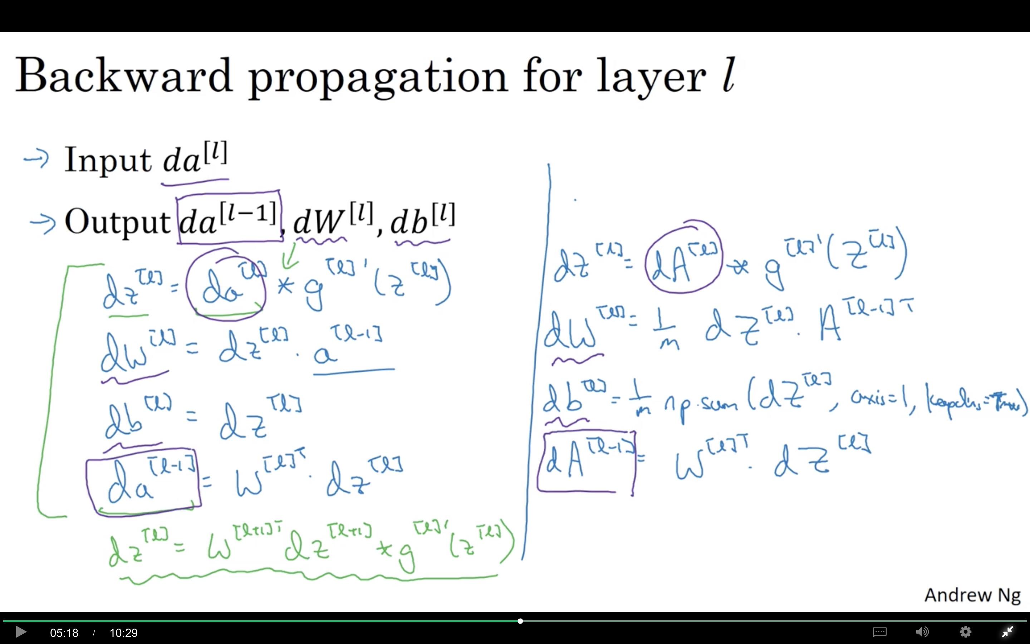

Slide 7
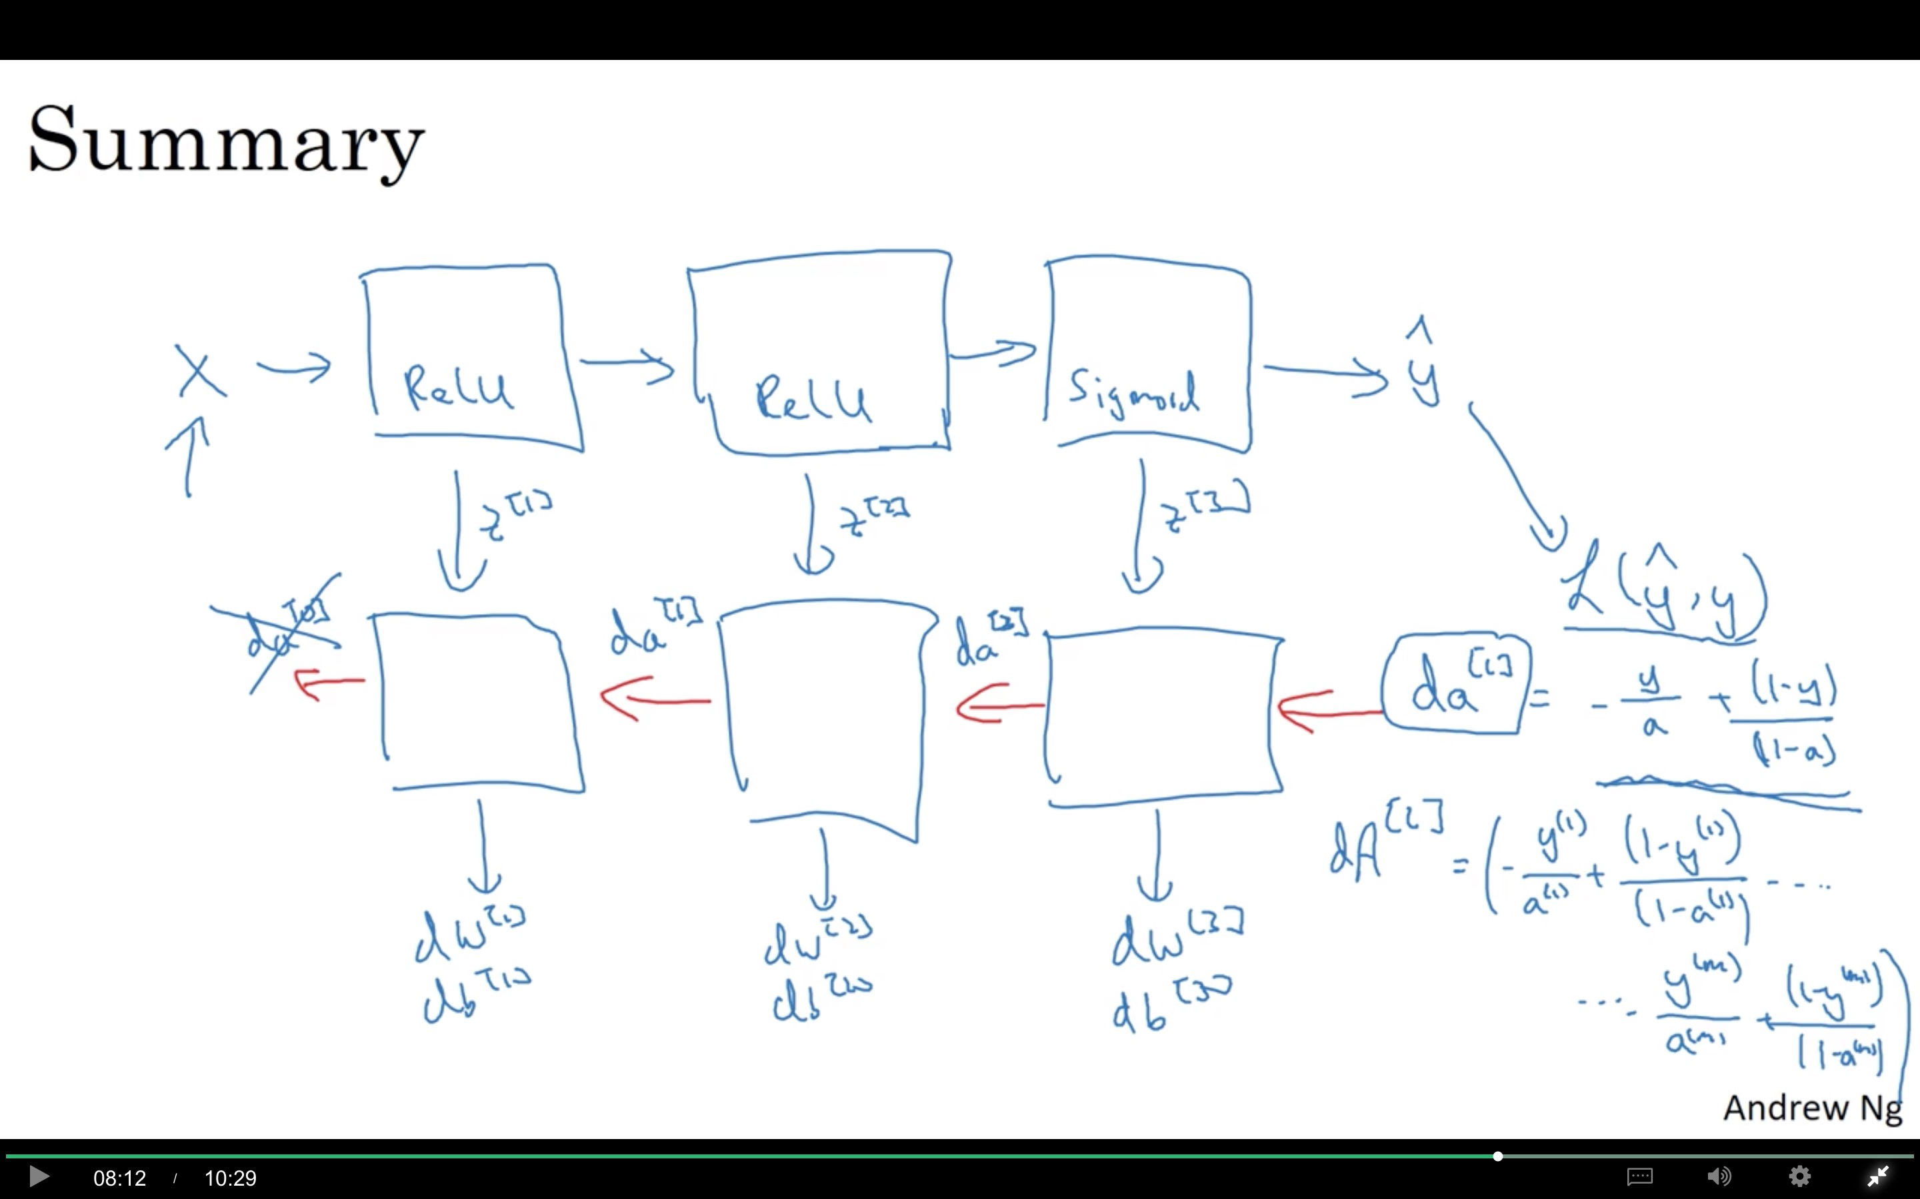

Slide 8
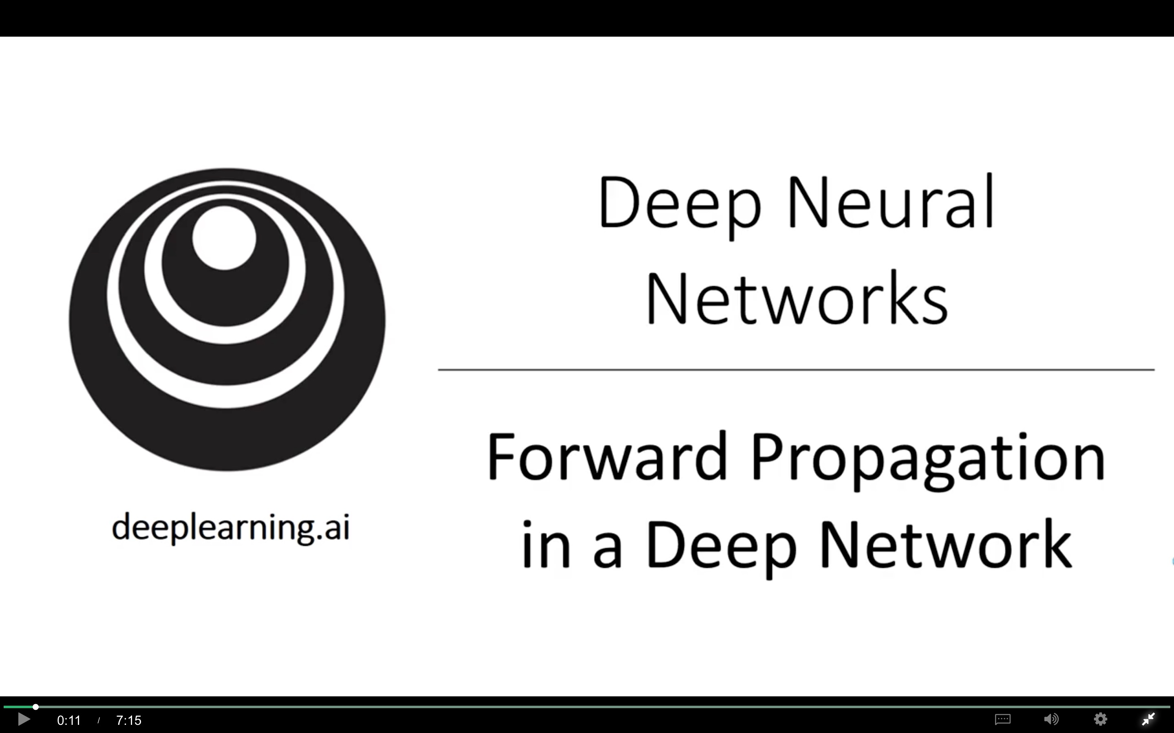

Slide 9
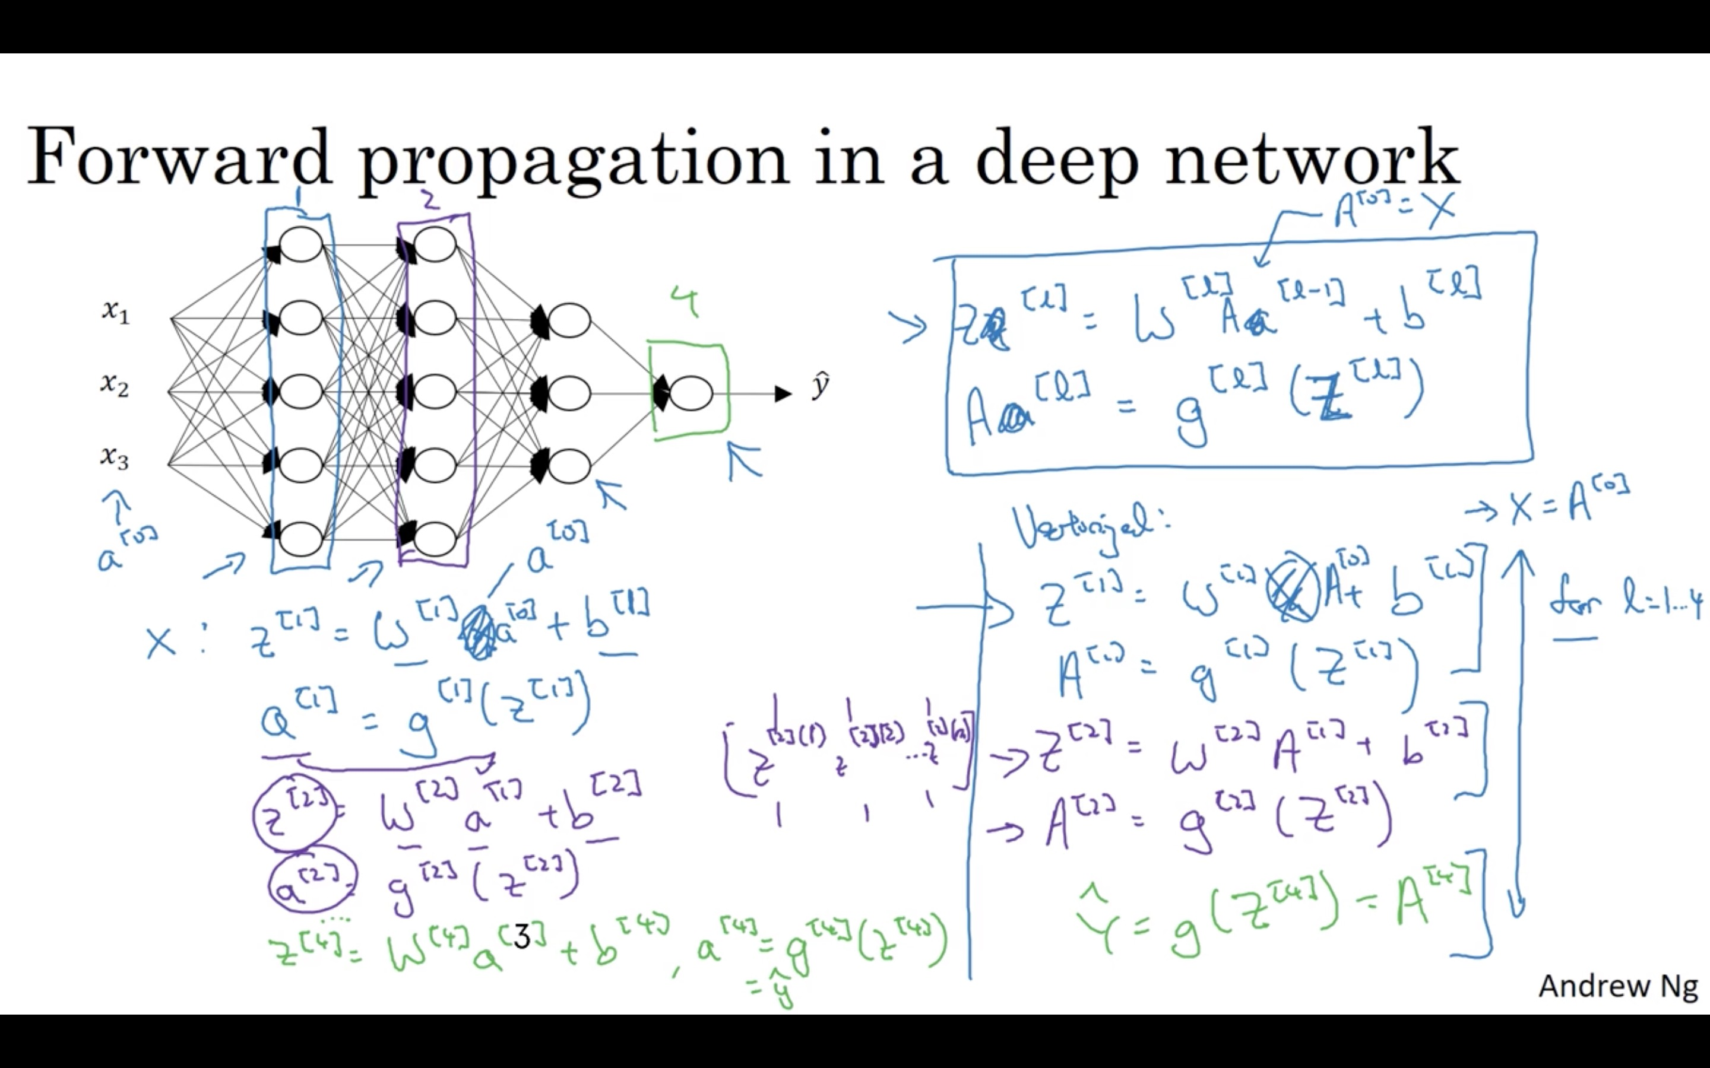

Slide 10
Deep Neural Networks
Getting your matrix
dimensions right

Slide 11
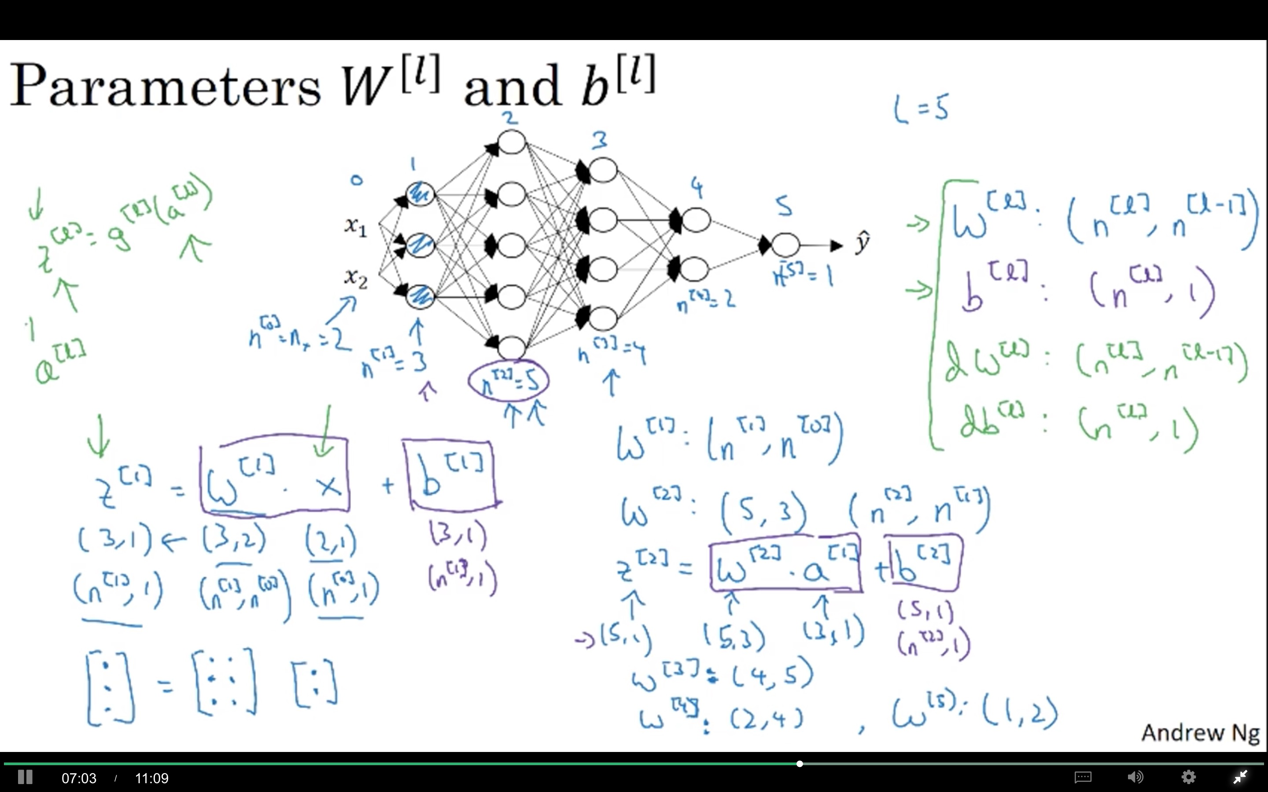

Slide 12
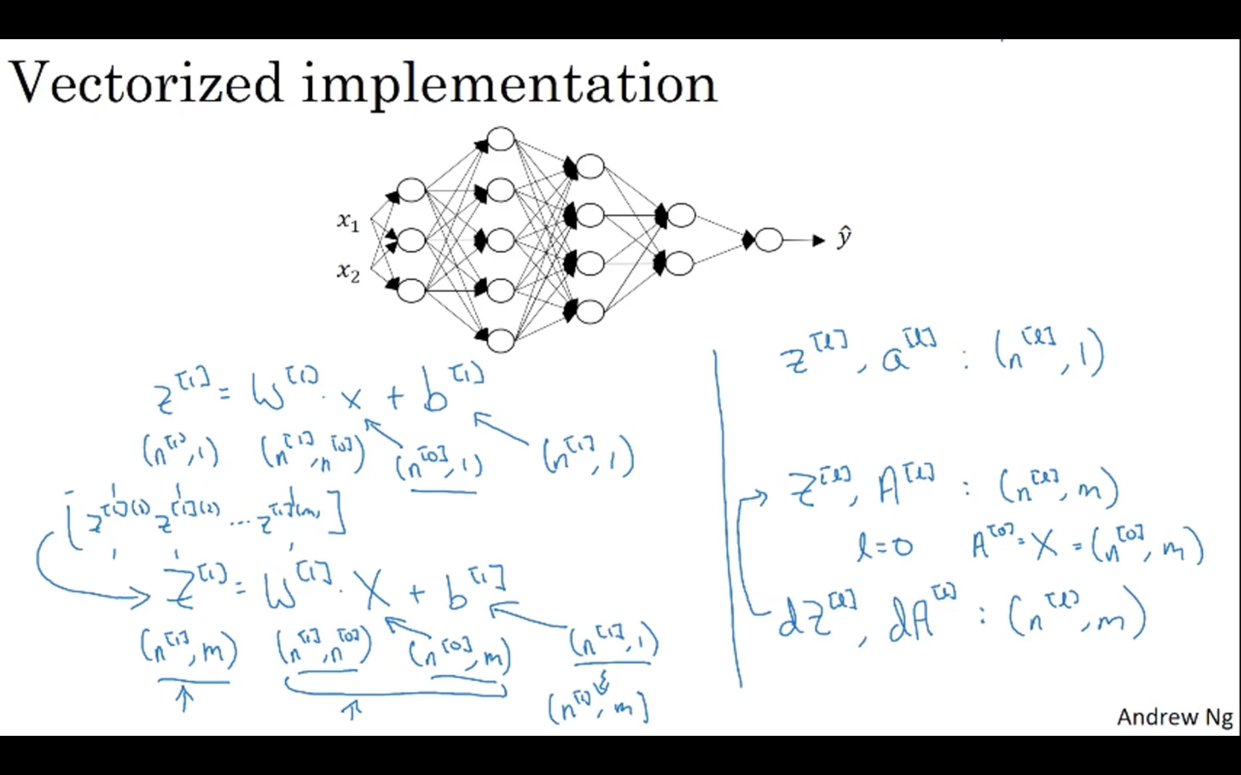

Slide 13
Deep Neural Networks
Why deep
representations?

Slide 14
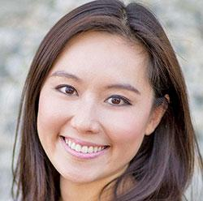
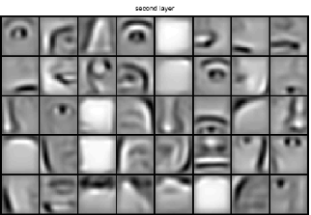
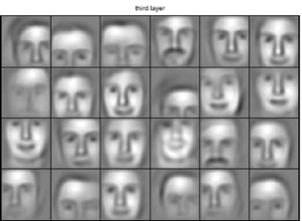
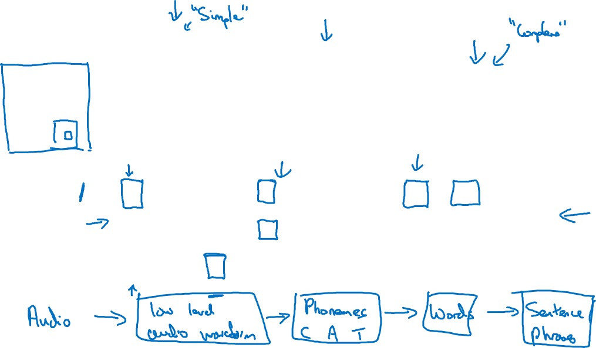
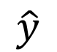
Intuition about deep representation
$$\hat{y}$$

Slide 15
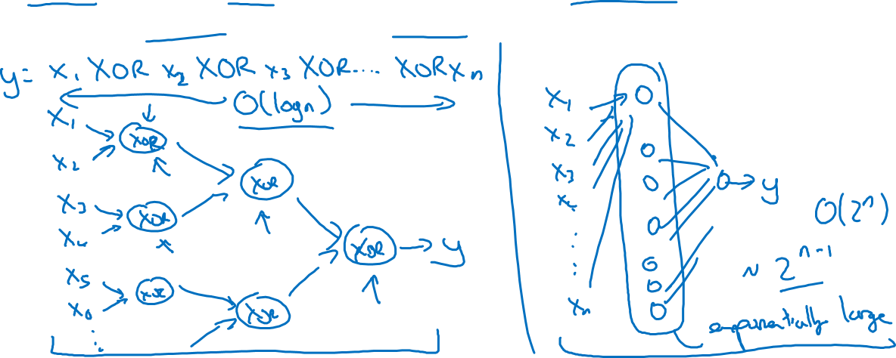
Circuit theory and deep learning
Informally: There are functions you can compute with a “small” L-layer deep neural network that shallower networks require exponentially more hidden units to compute.

Slide 16
Deep Neural Networks
Building blocks of
deep neural networks

Slide 17
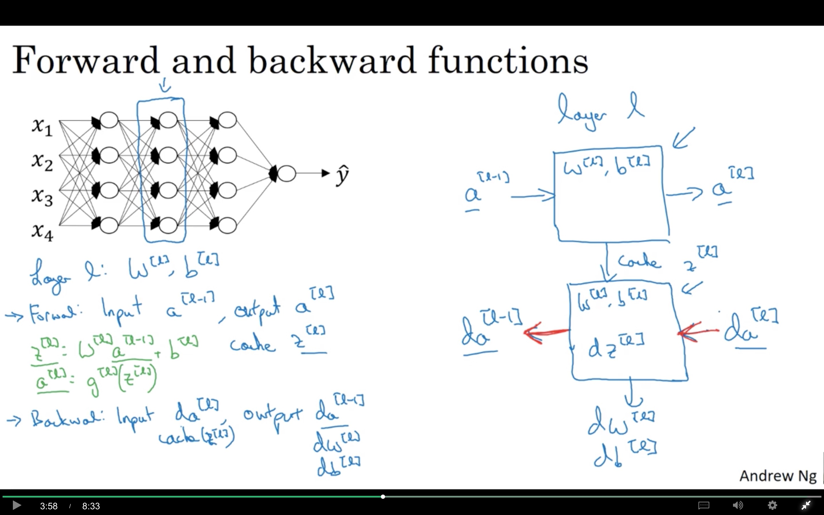

Slide 18
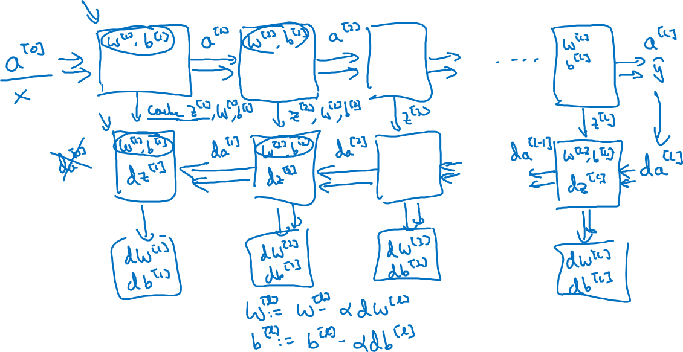
Forward and backward functions

Slide 19
Deep Neural Networks
Parameters vs
Hyperparameters

Slide 20
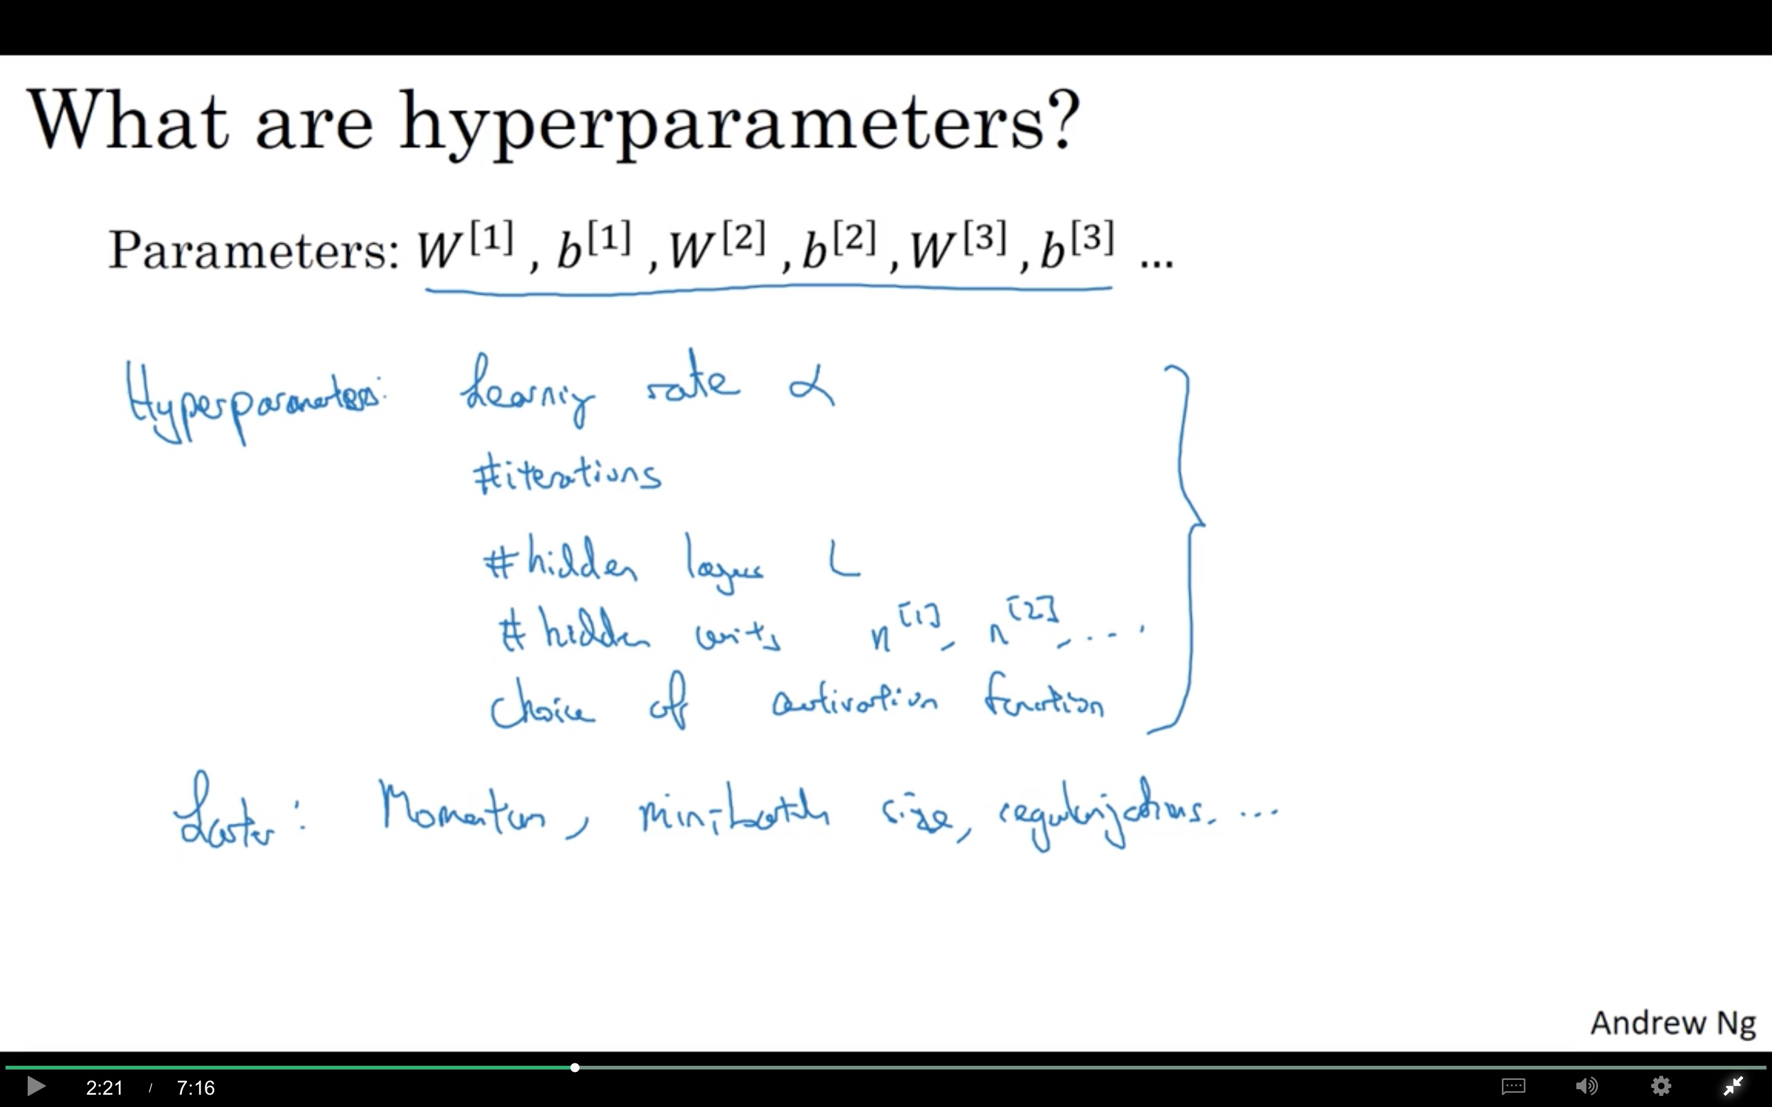

Slide 21

Applied deep learning is a very empirical process
Idea
cost $J$
Experiment
Code
# of iterations

Slide 22
Deep Neural Networks
What does this
have to do with
the brain?

Slide 23
